Slide 1
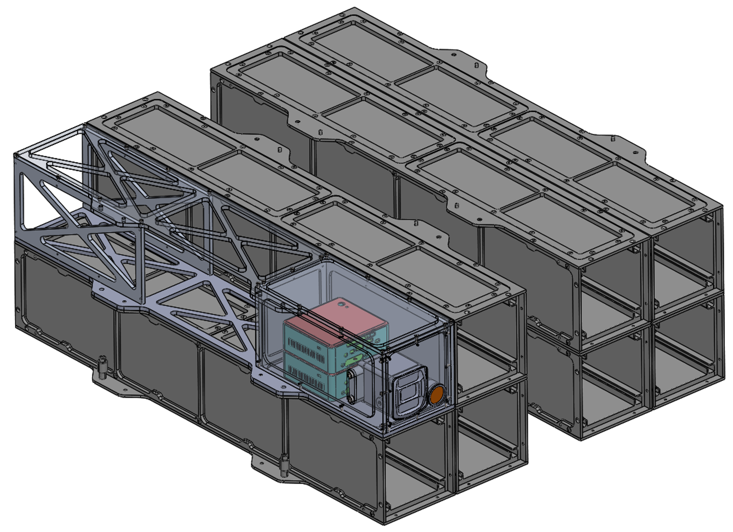

Slide 2
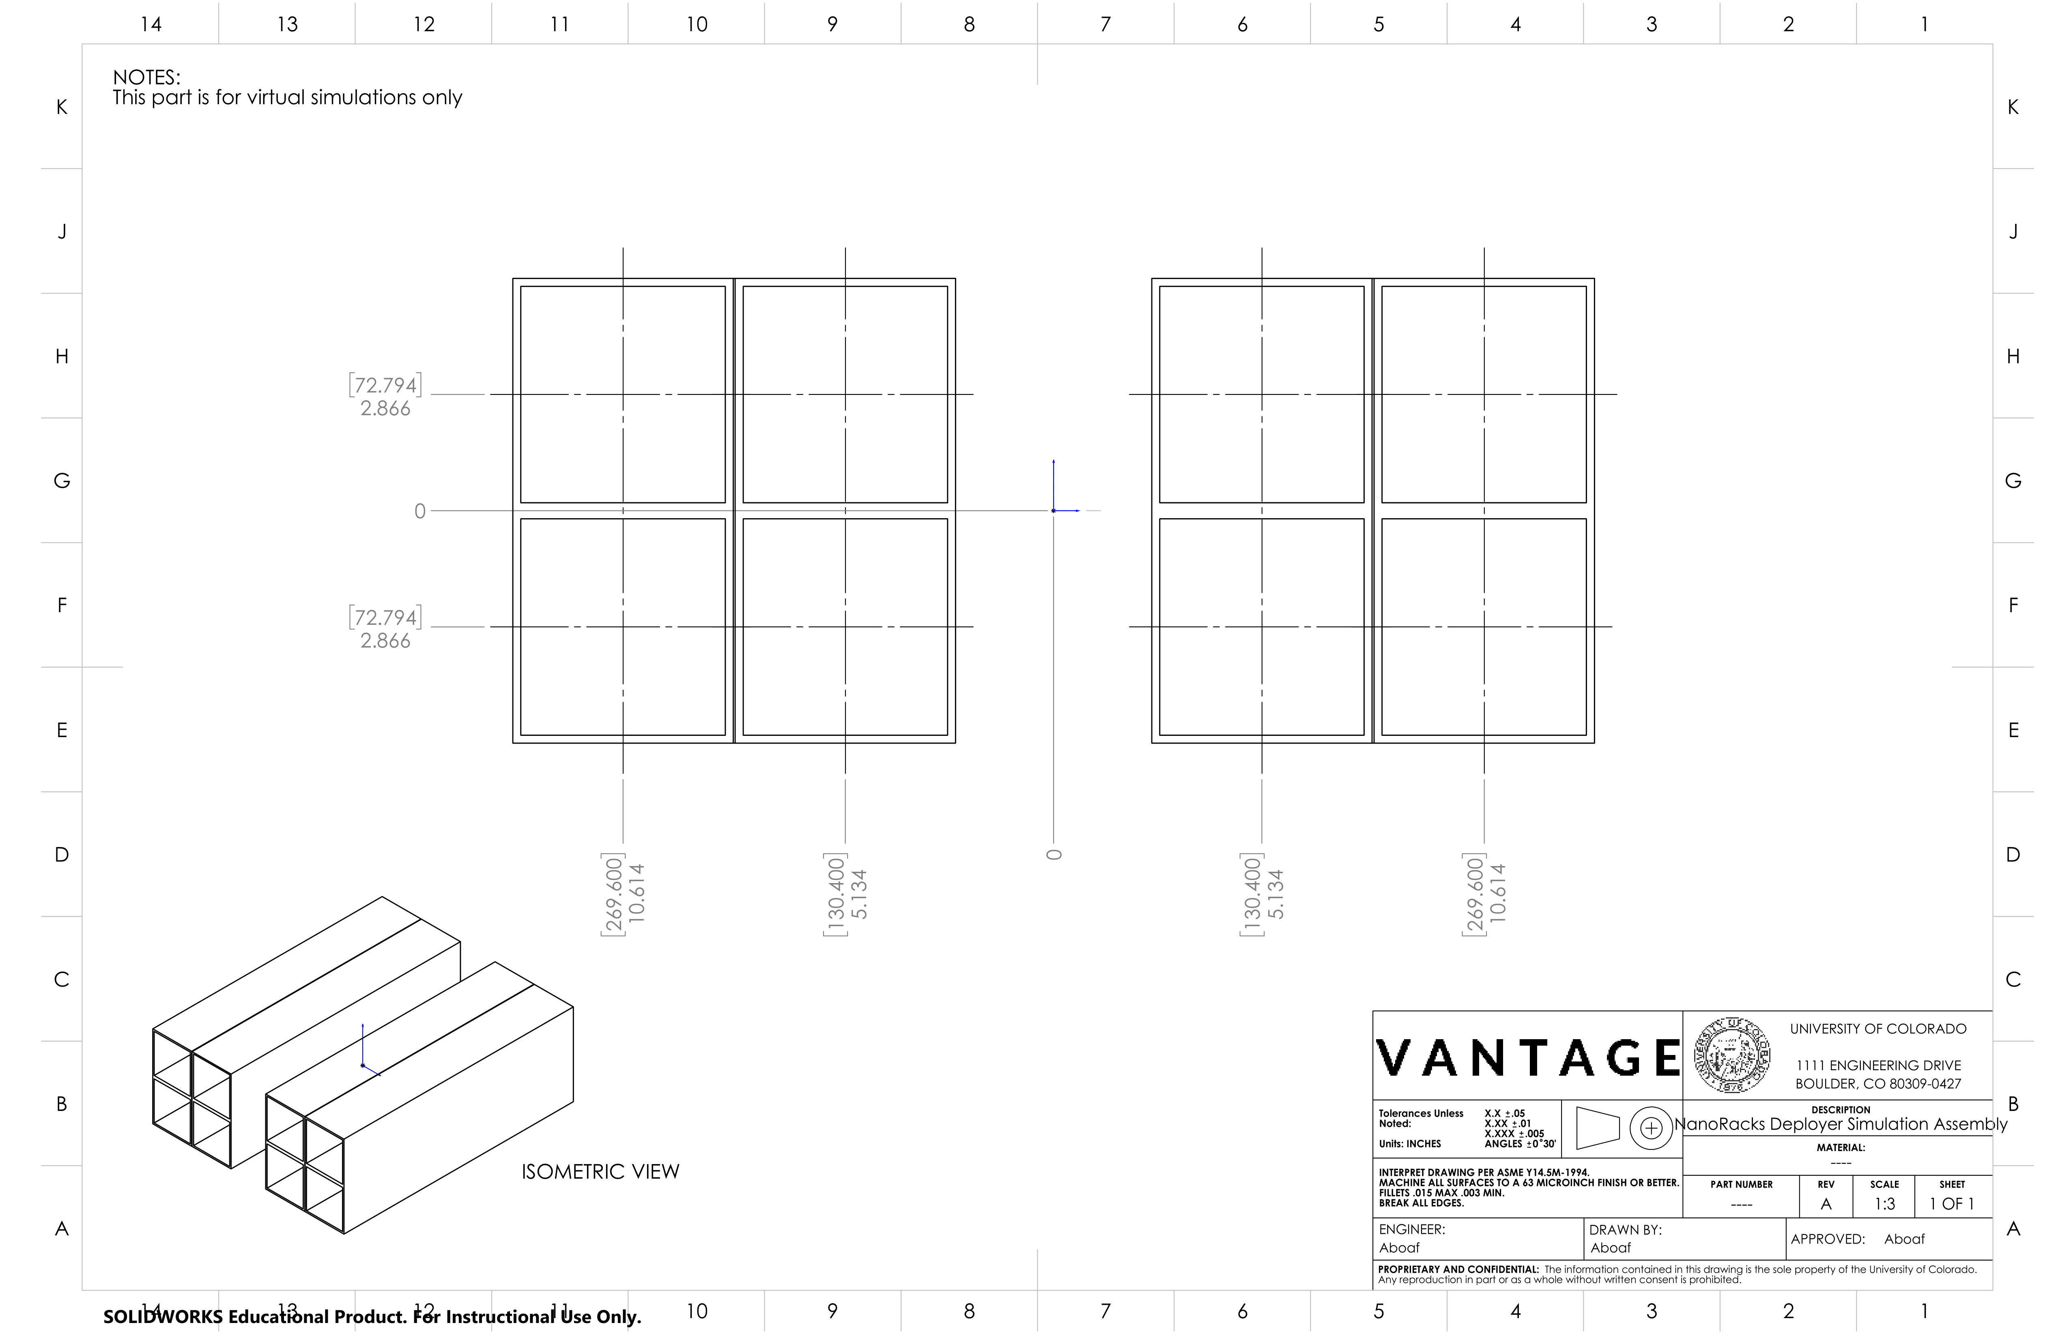
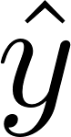
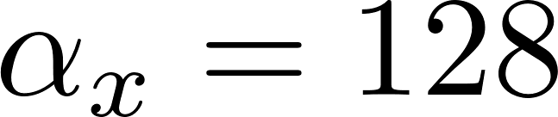
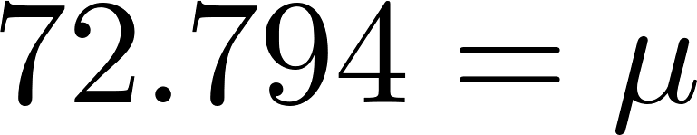
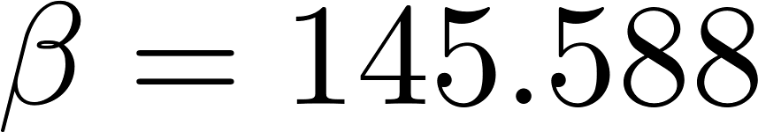
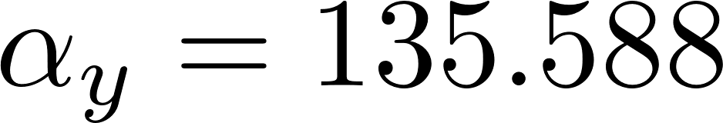
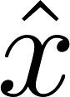
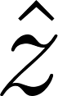
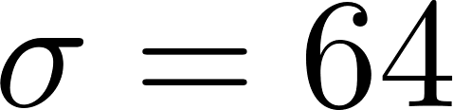
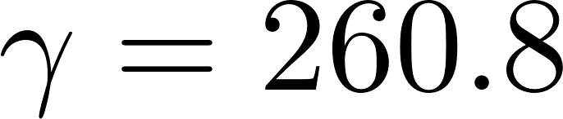
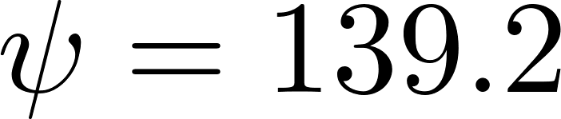
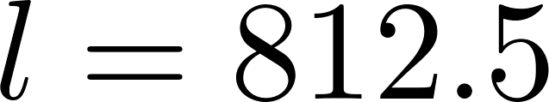
This page is used for understanding how VANTAGE’s and CubeSats’ locations are automagically setup in the C4D script.
Deployer Geometry Setup
Unit Vectors are for C4D Global Coordinate Frame
4
3
2
1
Nominal VANTAGE Tube Location
5
6
Deployer Origin in Simulations
7
8
Truth Data is reported in VCF
All units in [mm]

Slide 3
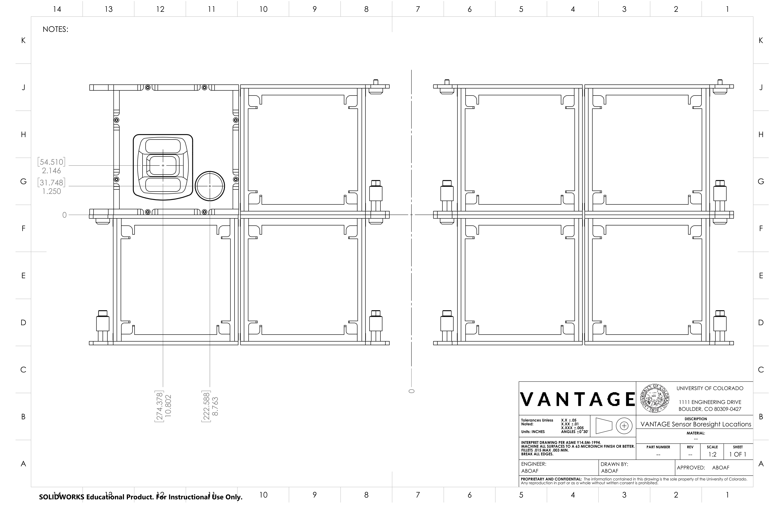
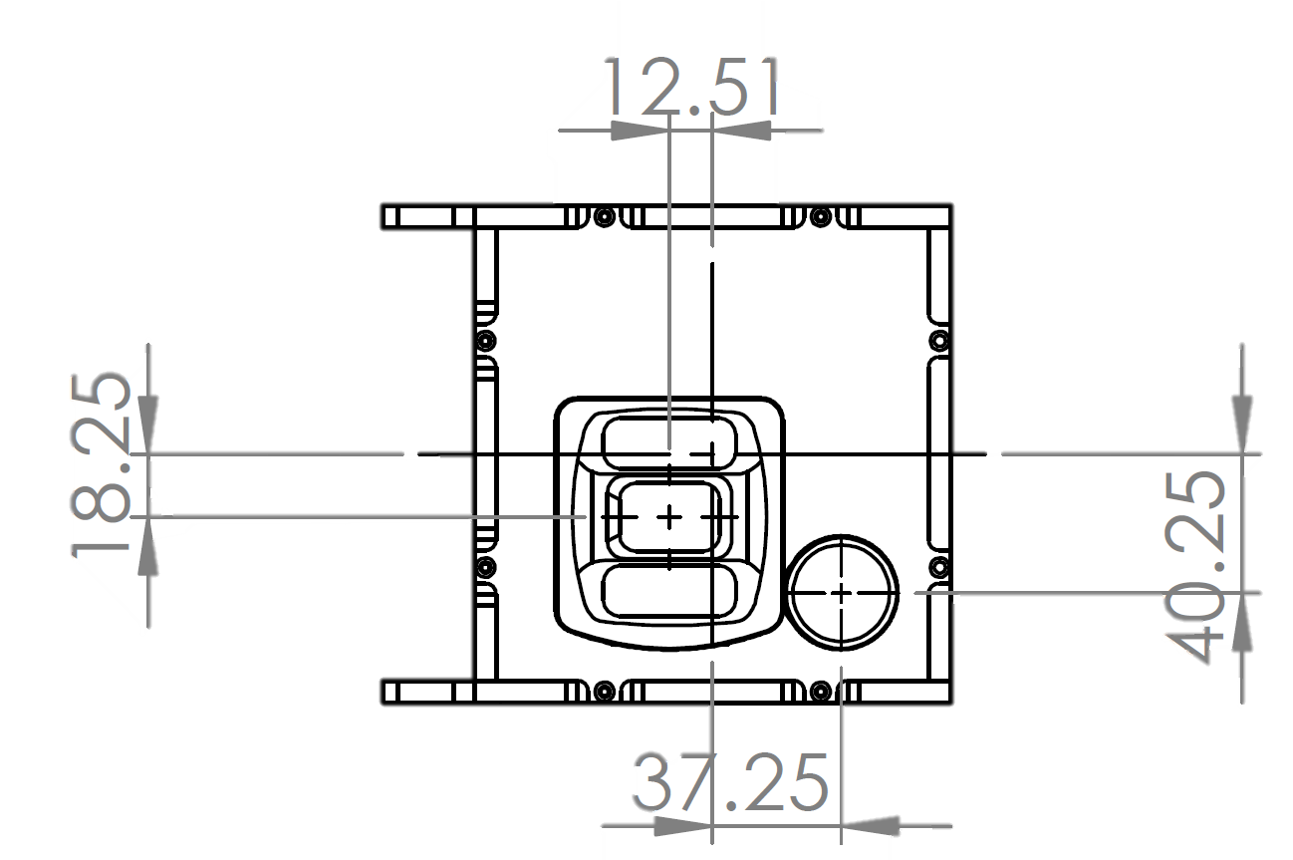
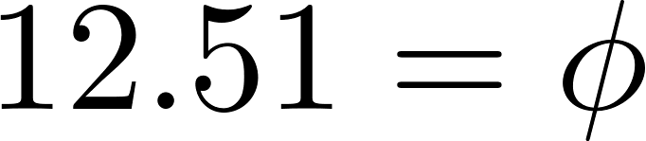
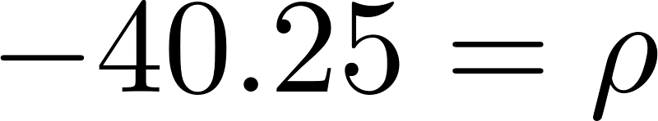
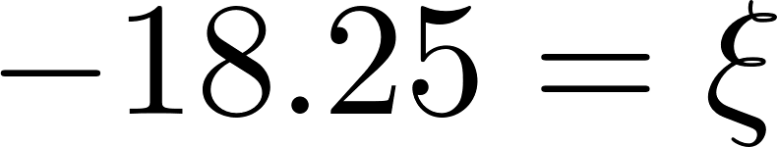
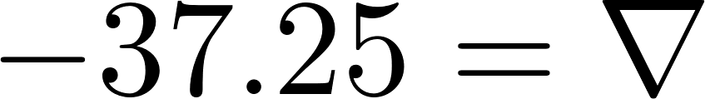
VANTAGE / Optical Frame Definition
Deployer Origin in Simulations
All units in [mm]

Slide 4
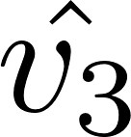
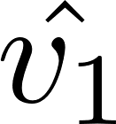
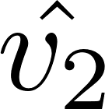
The frame origin is located at the aperture point of the camera-lens system.
This will be determined by calibration of the camera-lens system.
Rough focal length, f , is 35 [mm]
VANTAGE / Optical Frame Definition
(VCF / CCF)
THIS IS THE FRAME TRUTH DATA WILL BE REPORTED IN
All units in [mm]

Slide 5
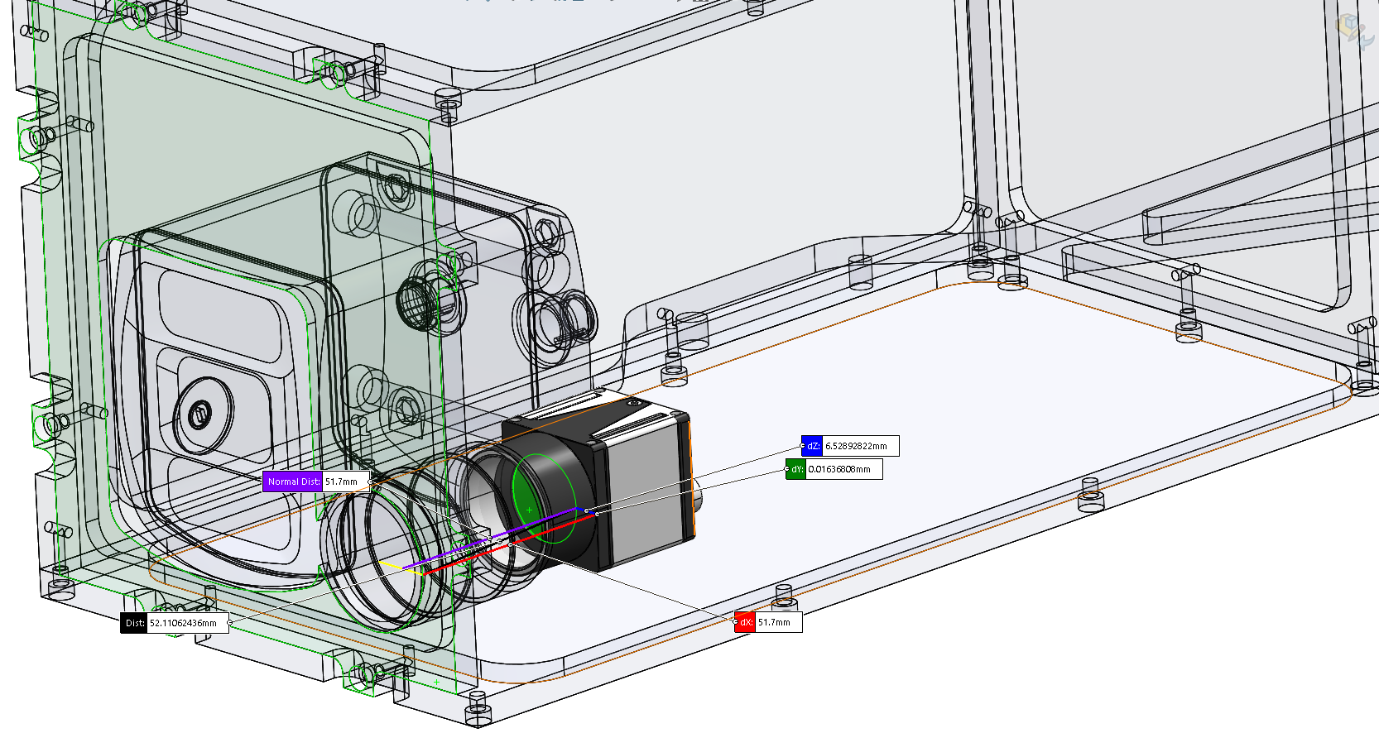
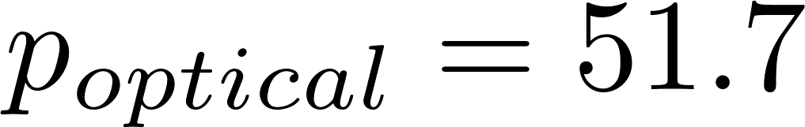
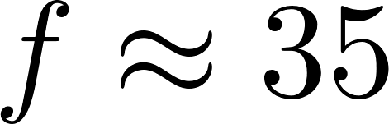
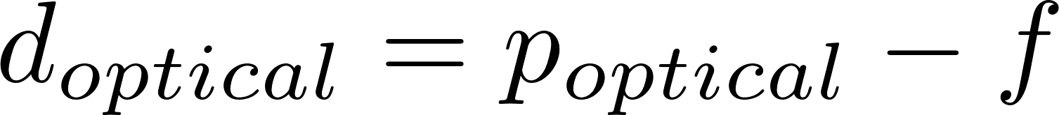

Location of Optical Sensor Plane and VCF Origin Relative to VANTAGE Front Plate
VCF Origin
Sensor Plane
All units in [mm]

Slide 6
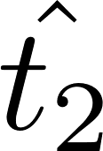
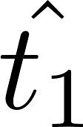
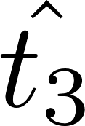
The frame origin is located on the glass of the ToF lens.
ToF Frame Definition
(TCF)
All units in [mm]

Slide 7
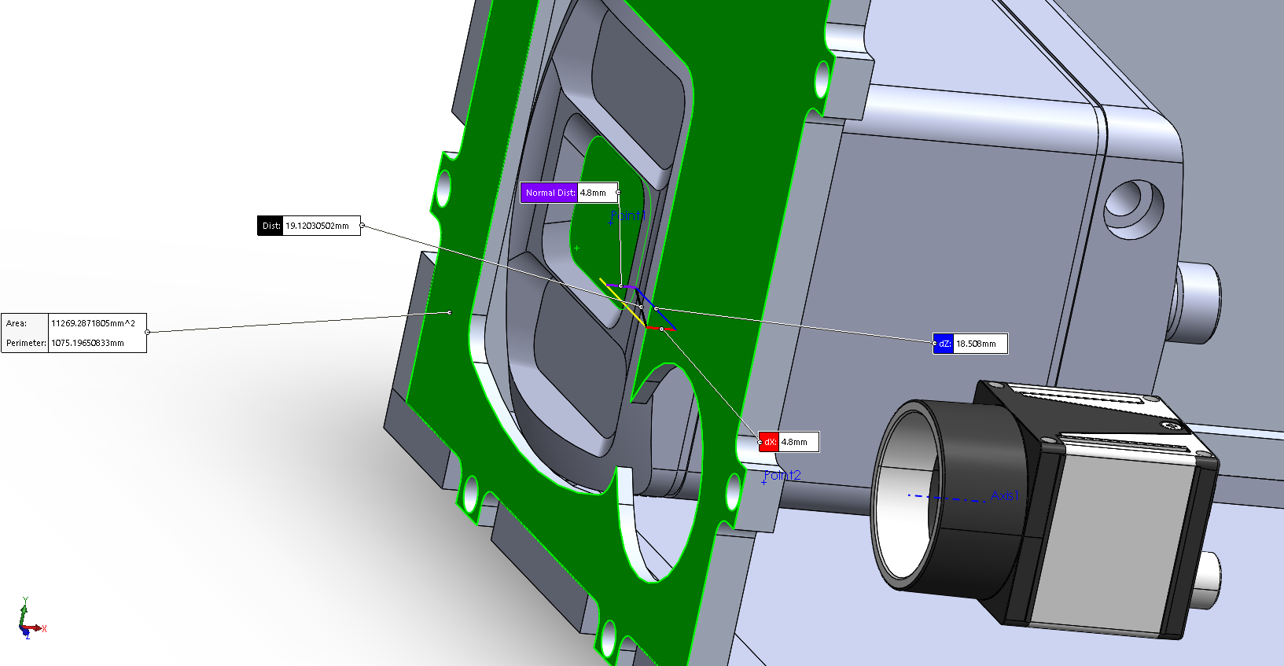
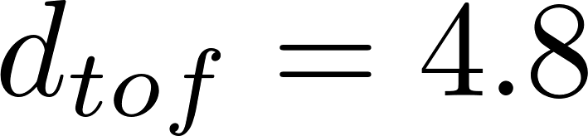

Location of TCF Origin Relative to VANTAGE Front Plate
TCF Origin
All units in [mm]

Slide 8
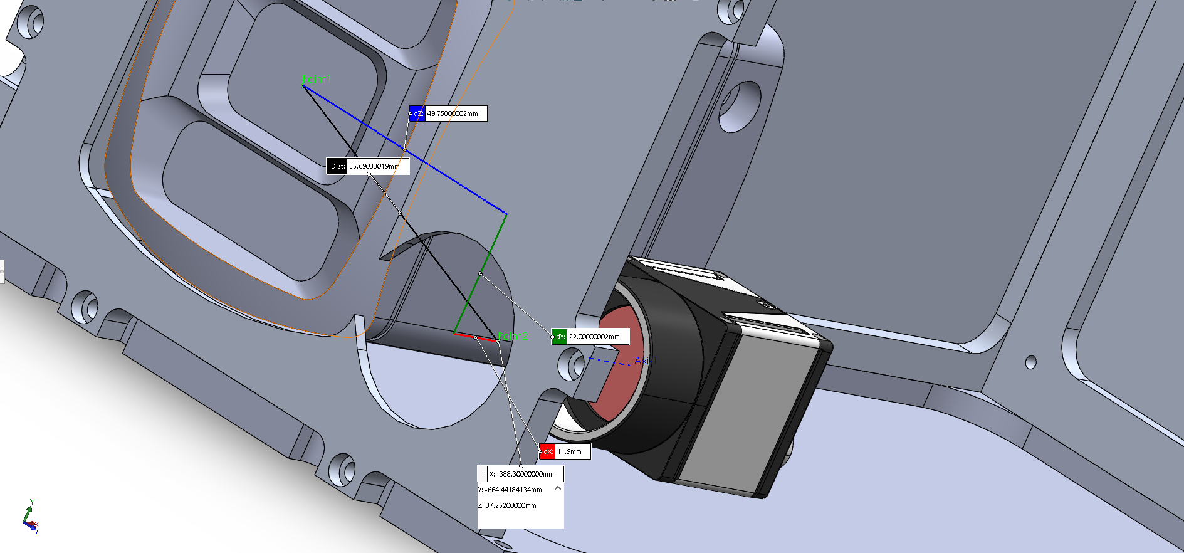
The exact dimensions of this definition are rough in the x direction, as we currently haven’t exactly characterized the focal length of the optical system.
These dimensions assume that a rough focal length, f , of 35 [mm]
TCF to VCF Distance
TCF Origin
VCF Origin
All units in [mm]

Slide 9
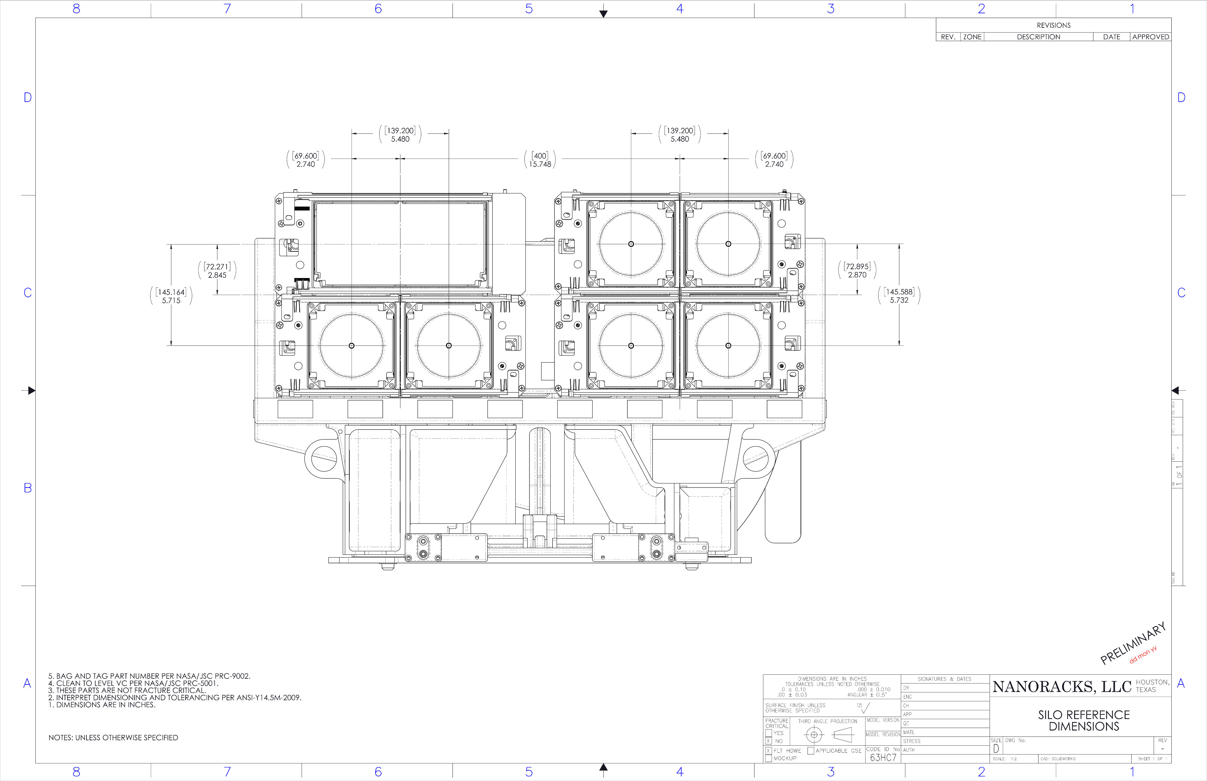
Actual NR Deployer Geometry

